Slide 1
LECTURE -3b
Descriptive Statistics Part (b)
Course Intructor
Engr. Naina Said

Slide 2
Interquartile Range (IQR)
CSE-422: Data Analytics
Put the list of numbers in order.
Then cut the list into four equal parts.
The values that divide each part are called the first, second, and third quartiles; and they are denoted by Q1, Q2, and Q3, respectively.
Q1 is the "middle" value in the first half of the rank-ordered data set.
Q2 is the median value in the set.
Q3 is the "middle" value in the second half of the rank-ordered data set.
IQR is not sensitive to the outlier.
The interquartile range is equal to Q3 minus Q1.

Slide 3
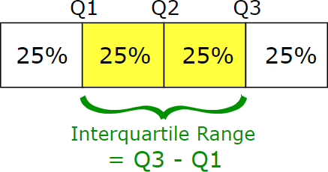
Interquartile Range (IQR)
CSE-422: Data Analytics
IQR is useful because it is less influenced by extreme values as it limitsthe range to the middle 50% of the values.

Slide 4
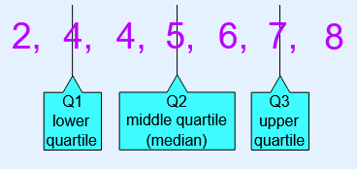
Example
CSE-422: Data Analytics
Data=5, 7, 4, 4, 6, 2, 8
Ordered = 2, 4, 4, 5, 6, 7, 8
Quartile 1 (Q1) = 4
Quartile 2 (Q2) which is also the Median = 5
Quartile 3 (Q3) = 7
IQR= 7-4 = 3

Slide 5
Examples
CSE-422: Data Analytics
Find the IQR for the following data set: 3, 5, 7, 8, 9, 11, 15, 16, 20, 21.
Find the IQR for the following data set: 1, 2, 5, 6, 7, 9, 12, 15, 18, 19, 27.

Slide 6
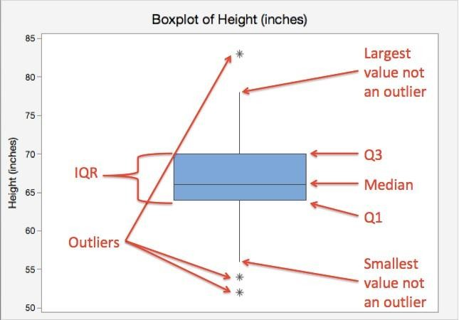
Box and Whisker Plot
CSE-422: Data Analytics
Box and whisker plot gives us 5 number summary of a dataset. minimum, Q1, Q2(median), Q3, and maximum.

Slide 7
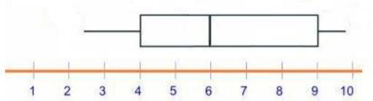
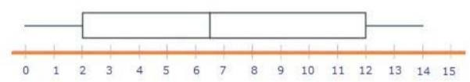
Examples
CSE-422: Data Analytics
What is the IQR for the information shown in the box and whisker plotbelow:
What is the IQR, Range and Median for the information shown in the box and whisker plot below:

Slide 8

Coefficient of Variation
CSE-422: Data Analytics
Also known as “relative standard deviation”
But why do we need it?
CV is helpful when we are trying to compare things that could be relative to their
respective domains.
When we want to compare two different datasets (different scales), CV should be used.
When we want to compare two similar datasets (same scales), SD should be used.

Slide 9
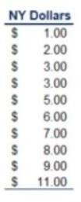
Example
CSE-422: Data Analytics
Suppose we want to analyze the pizza prices in different restaurants in New York. We have sample data from 10 restaurants. The prices in dollars are as follow:

Slide 10
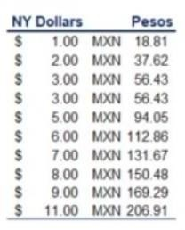
Example
CSE-422: Data Analytics
Now suppose there is a foreigner who only have Mexican pesos. To him, the prices will look more like 18.81 pesos to 206.91 pesos, given the exchange rate of 18.81 pesos for one dollar.

Slide 11
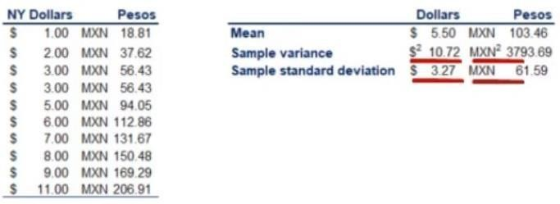
Example 2
CSE-422: Data Analytics
If we calculate the sample variability, we get standard deviations of 3.27 and
61.59 for the same pizza at the same 11 restaurants in New York City. The
difference is because of difference in currency (or scale)
This is the scenario where we have to use CV.
If we calculate the CV for both, the result will be the same, i.e. 0.60

Slide 12
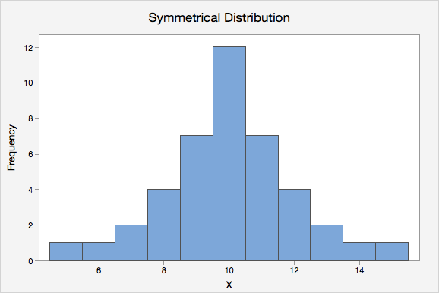
Symmetrical Distribution
CSE-422: Data Analytics
We have seen histograms previously.
Histograms give us a sense of what our data looks like.
The histogram below is “normal” or “symmetrical”
But not every data is normally distributed!

Slide 13
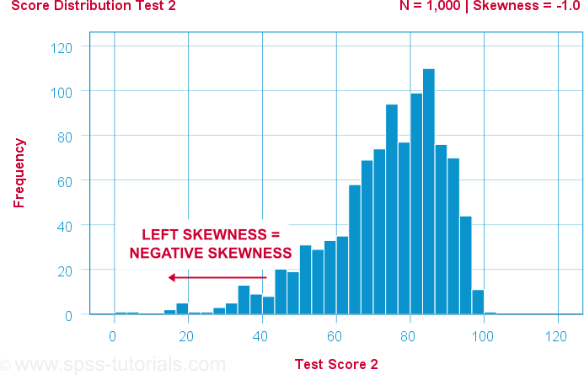
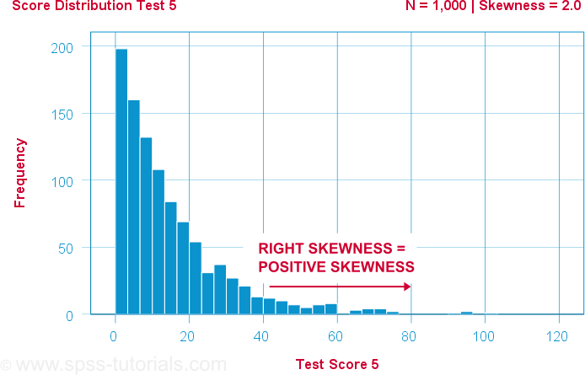
Skewness
CSE-422: Data Analytics
Skewness refers to the asymmetry of a distribution.
Normal distribution is symmetric on both sides of the mean.
A skewed distribution is not symmetric.
Left (Negatively) Skewed Histogram
Right (positively) Skewed Histogram

Slide 14
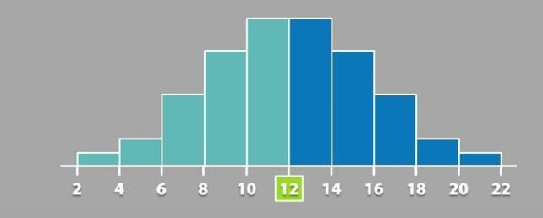
Mean, Median for Symmetrical Distribution
CSE-422: Data Analytics
Mean=Median

Slide 15
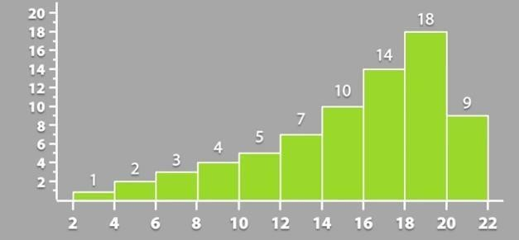
Mean, Median for Negatively Skewed Distribution
CSE-422: Data Analytics
Mean<Median

Slide 16
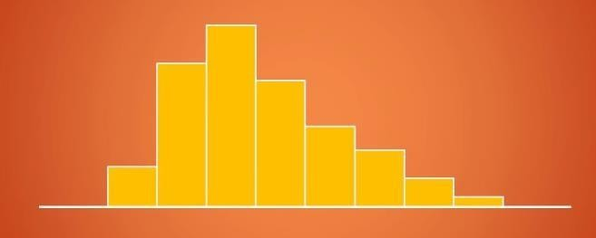
Mean, Median for Positively Skewed Distribution
CSE-422: Data Analytics
Mean>Median

Slide 17
CSE-422: Data Analytics
Pearson Method for Skewness Calculation
Skew = mean-mode/std dev
When mode of the data is not given, we use
Skew=3(mean-median)/std dev

Slide 18
Interpreting the Value of Skew
CSE-422: Data Analytics
If the value is 0, we consider the distribution to be normally distributed.
if the value is >0 , we consider the distribution to be positively skewed or right-
skewed.
if the value is <0, we consider the distribution to be negatively skewed.

Slide 19
Why Do We Care About Skewness
CSE-422: Data Analytics
Many machine learning models (specifically the linear models) work on the assumption that the distribution of the independent variable and the target variable are similar. Therefore, knowing about the skewness of data helps us in creating better linear models.
Knowing the skewness of the data can also help us identify class imbalance when dealing with
ML problem.
Skewed distribution can be converted to normal distribution using
Power Transformation
Log Transformation
Exponential Transformation

